Slide 1
Unlocking the Mystery of the Common Core: Reading and Writing with the Rays
Welcome!
Jodi Pushkin: Newspaper in Education
Deborah Kozdras: University of South Florida Stavros Center
http://nieonline.com/tbtimes/downloads/supplements/2013_rays.pdf

Slide 2
What is Black and White & Still Read All Over?

Slide 3
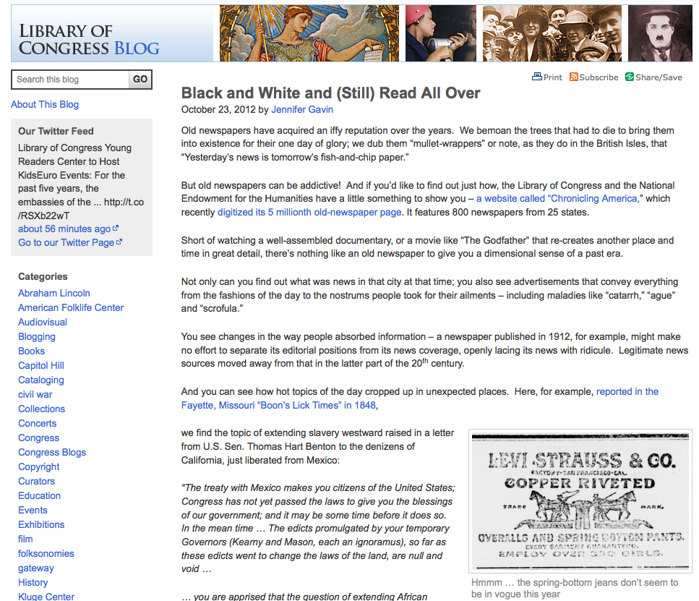
What is Black and White & Still Read All Over?
http://blogs.loc.gov/loc/2012/10/black-and-white-and-still-read-all-over/

Slide 4
Unlock the Mystery of the Common Core

Slide 5
“Read like a detective, write like a reporter.”

Slide 6
Newspaper in Education (NIE)
The Tampa Bay Times NIE program is a cooperative effort between schools and the Times to promote the use of newspapers in print and electronic form as educational resources.
The goal of NIE is to build future, life-long readers, productive citizens and critical thinkers.

Slide 7
Times NIE services
The Tampa Bay Times Newspaper in Education program provides free resources to Citrus, Hernando, Hillsborough, Manatee, Pasco and Pinellas counties.
The TBT NIE provides more than 5-million newspapers, electronic licenses and curriculum guides to classrooms around Tampa Bay each year
TBT NIE hosts teacher workshops
TBT NIE provides teachers with free lesson plans in print and online – www.tampabay.com/nie.

Slide 8
Developing daily habits
Using the newspaper in your classroom and NIE curriculum on a regular basis helps students develop daily reading habits that they will carry through their lives.
The Times provides a vital link to the real world for students who too often do not realize the value of their academic programs. The study of today's critical issues, events and people helps students understand the past and see a role for themselves in their future world.

Slide 9
Engaging Readers
Combining the use of print newspapers and technology in the classroom will engage your struggling readers, bored underachievers or IB/advanced students.
(We know certain classrooms need to have the newsprint version, so we temporarily have a limited number of print copies available.)

Slide 10
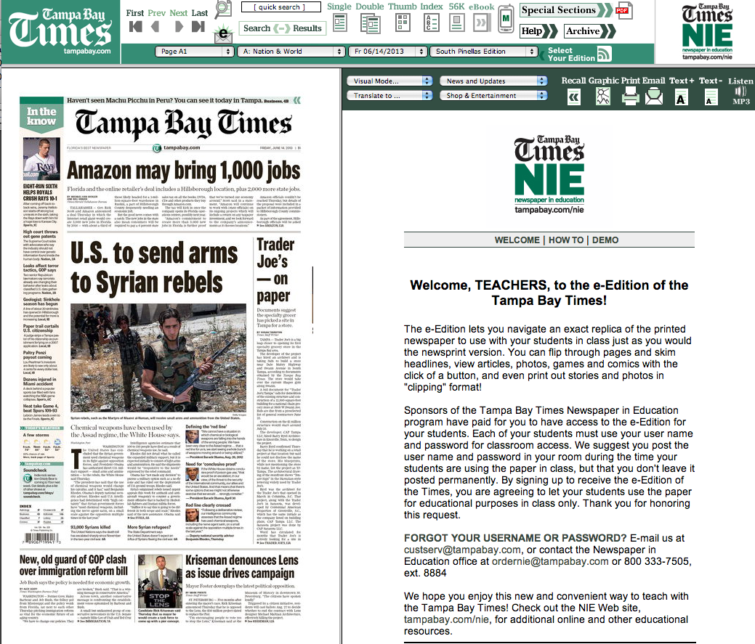

Slide 11
Cool features
You can access all seven editions in all counties.
E-Mail Articles to your friends or family.
Save or print the articles you want to keep.
Search for past articles.
E-mail notification for research and projects.

Slide 12
Access to the electronic edition
The access for the electronic edition is given to each media specialist.
Go to www.tampabay.com/nie
Click on Log in here
Enter school user name
Enter password (news)

Slide 13
Access to the electronic edition
Teachers can order licenses on www.tampabay.com/nie
Check it out for yourself!
Go to www.tampabay.com/nie
Click on Log in here
Enter: nie36699
Enter password: news

Slide 14
CSI-R Model for Reading -> Writing
Content: What content do you want to teach?
Standards/Skills/Strategies: What literacy standards, skills, or strategies will you use help students learn the content.
Investigate: Immerse the students within a lesson where they investigate to find evidence to answer the question.
Report: Show what you know (write, podcast, blog, movie, etc.)

Slide 15
Writing texts and purposes
Write arguments to support claims in an analysis of substantive topics or texts, using valid reasoning and relevant and sufficient evidence.
Write informative/explanatory texts to examine and convey complex ideas and information clearly and accurately through the effective selection, organization, and analysis of content.
Write narratives to develop real or imagined experiences or events using effective technique, well-chosen details, and well-structured event sequences.

Slide 16
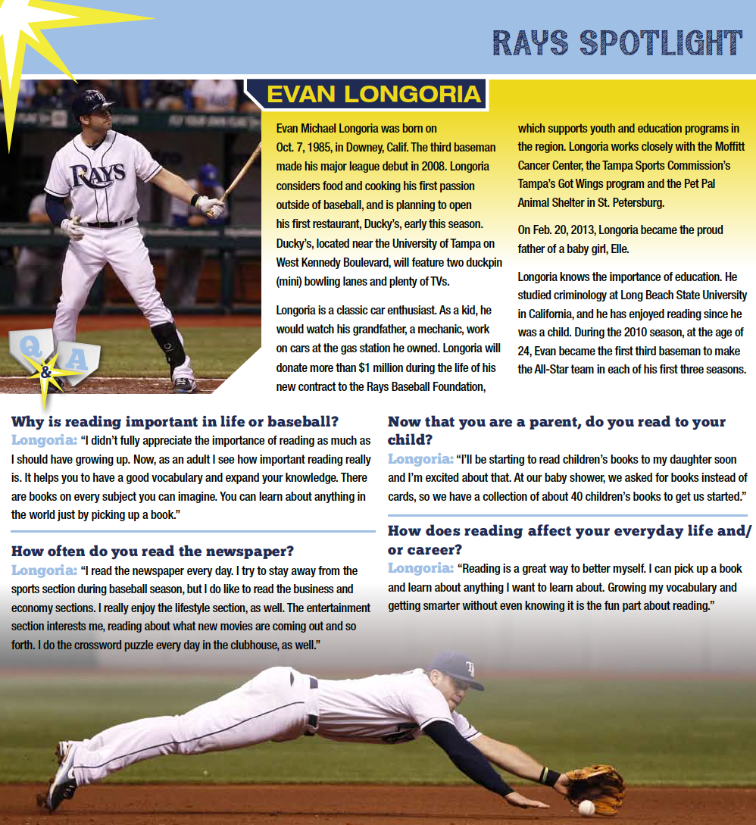
Write Arguments to Support Claims
Page 9
Pretend you are Evan trying to persuade Rays’ fan about the importance of reading.
Use evidence from the interview and write a blog post.

Slide 17
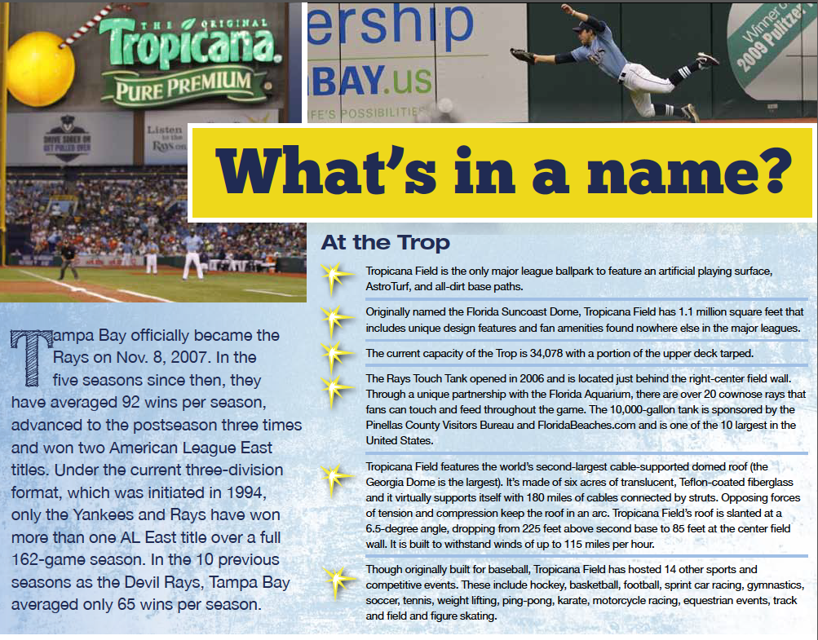
Write Informative/Explanatory Texts
Page 10
Compose three tweets that explain the history of the Rays and the Tropicana field.
Remember, there are only 140 characters in a tweet so you have to compose an informative sentence.

Slide 18
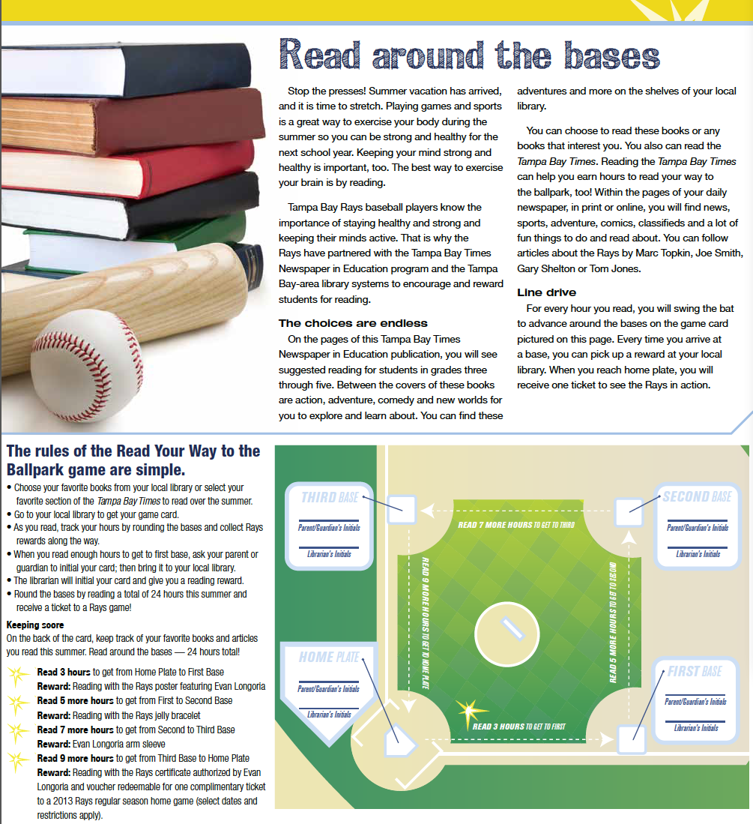
Write Informative/Explanatory Texts
Page 3
Write a letter/email to a friend that explains what the “Read Your Way to the Ballpark” game is and what the rules are.

Slide 19
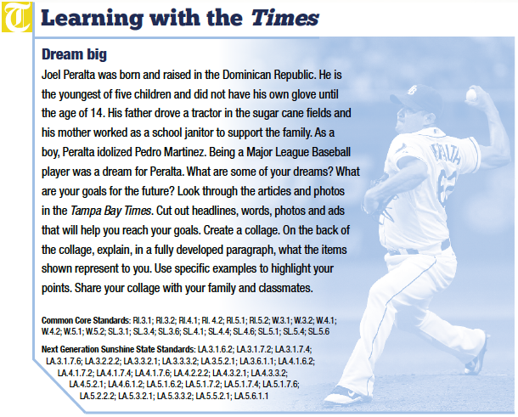
Write Narratives

Slide 20
Production & Distribution of Writing
Produce clear and coherent writing in which the development, organization, and style are appropriate to task, purpose, and audience.
Develop and strengthen writing as needed by planning, revising, editing, rewriting, or trying a new approach.
Use technology, including the Internet, to produce and publish writing and to interact and collaborate with others.

Slide 21
Research to build and connect knowledge
Conduct short as well as more sustained research projects based on focused questions, demonstrating understanding of the subject under investigation.
Gather relevant information from multiple print and digital sources, assess the credibility and accuracy of each source, and integrate the information while avoiding plagiarism.
Draw evidence from literary or informational texts to support analysis, reflection, and research.

Slide 22
Conduct research projects based on focused “text-dependent questions”

Slide 23
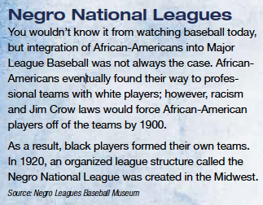
Gather relevant information from multiple print and digital sources . . .
Page 12
Using the newspaper articles from the Tampa Bay Times as models, write an article about the Negro National Leagues based on research from a variety of sources.

Slide 24
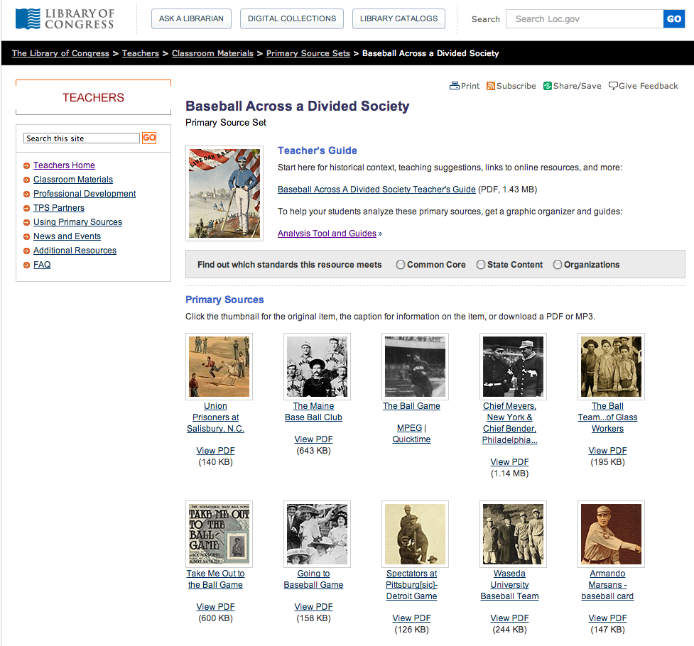
. . . assess the credibility and accuracy of each source . . .
http://www.loc.gov/teachers/classroommaterials/primarysourcesets/baseball/
http://www.nlbm.com/

Slide 25
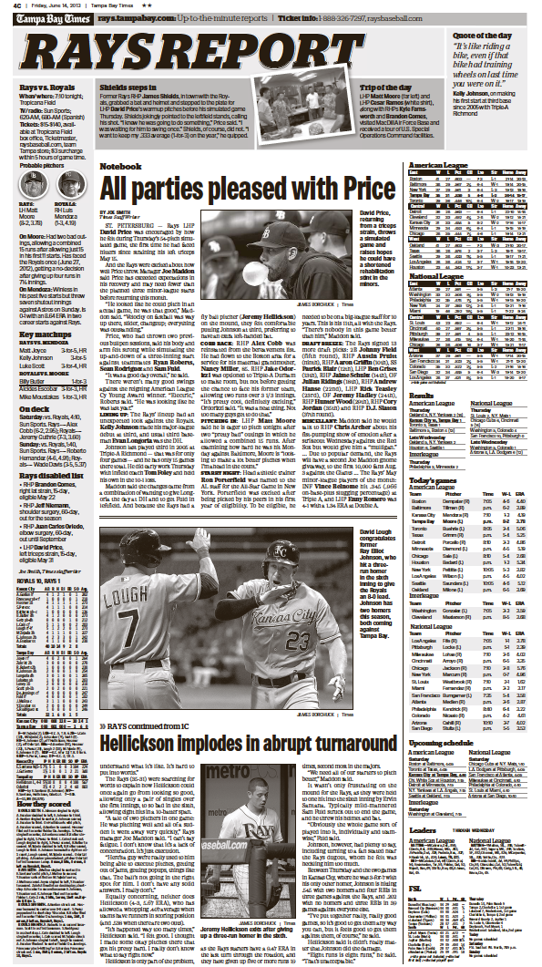
Draw evidence from texts to support analysis, reflection, and research.
Reflect on the Tampa Bay Rays’ Baseball season.
Using newspaper articles and statistics, write an opinion column based on the evidence you find.

Slide 26
Range of Writing
10. Write routinely over extended time frames (time for research, reflection, and revision) and shorter time frames (a single sitting or a day or two) for a range of tasks, purposes, and audiences.

Slide 27
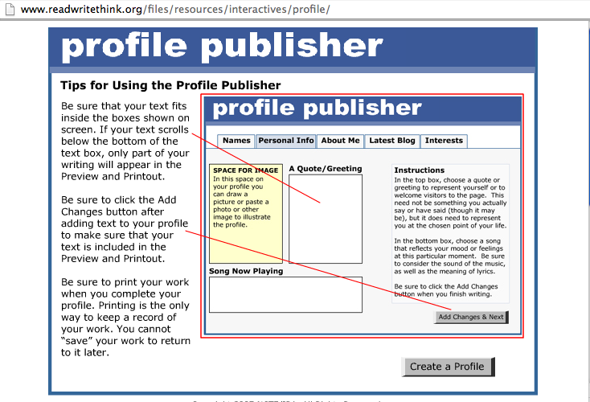
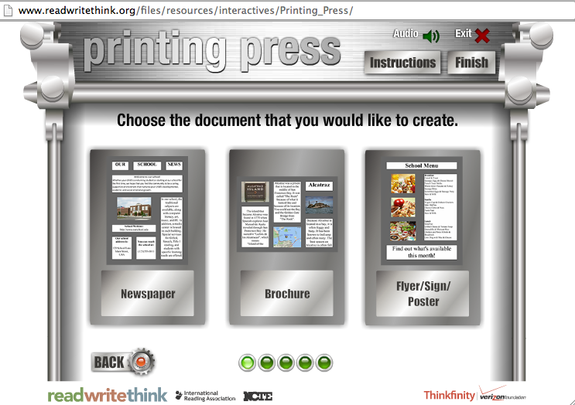
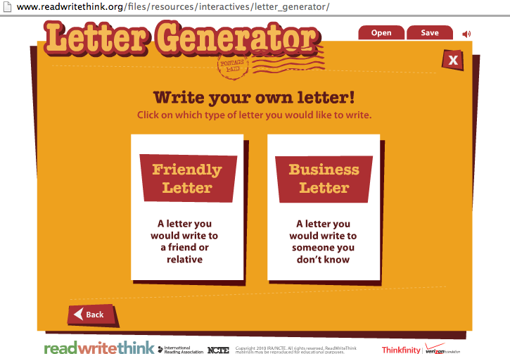
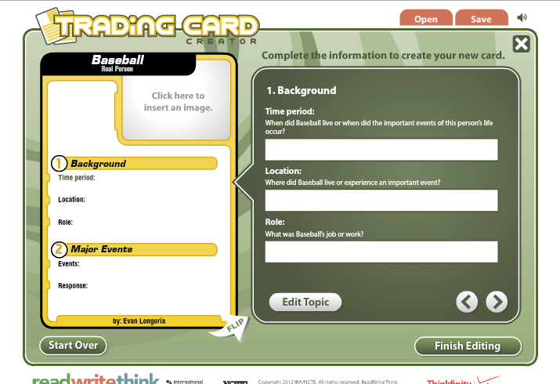

Slide 29
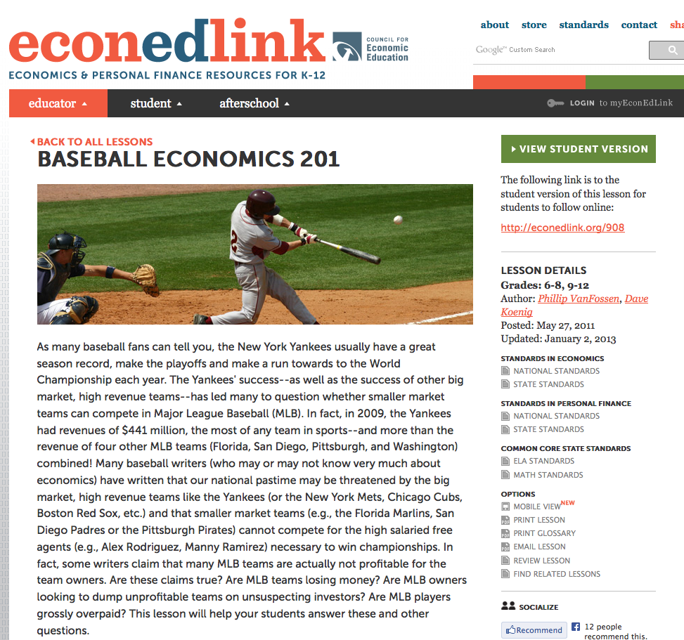
Using News Sources for Economics
http://www.econedlink.org/lessons/index.php?lid=908&type=educator

Slide 30
Thank You!
Contact Information:
jpushkin@tampabay.com Jodi Pushkin: NIE
dkozdras@usf.edu Deborah Kozdras: Stavros
Website for NIE: tampabay.com/nie
Baseball Primary Sources:
LOC Primary Source Set: http://www.loc.gov/teachers/classroommaterials/primarysourcesets/baseball/

