Slide 1
Tampabay.com/nie

Slide 2
I am a listener, a writer, a podcaster. I love embedding in strangers’ lives and sharing their stories. When I was 6 years old, growing up in D.C. during the Watergate scandal, I told my parents I was going to be a journalist. I was editor of the newspaper at the University of Virginia, then worked in newsrooms across the East Coast. Over the last 30 years, I have written more than 3,000 stories. I came to the Times in 2000 and have followed a feral child who was adopted, a girl whose dad dropped her off a bridge and a dying boy waiting for his miracle. I’ve won dozens of national awards, including the Pulitzer Prize for feature writing. I’m also a mother, a dog lover and die-hard Deadhead.

Slide 3
C.A.S.T
Character:
Write about people, not issues -- could also be a town, building, corporation
Look for stakeholders -- everyman vs. outlier
You need access, insight, introspection
Action:
Something has to happen -- Can I watch it unfold? Recreate it?
A quest, question or complication
Tension, motive, what’s at stake?
Setting:
Sense of place -- Movie openings, transport the readers
Drone-level overview
Or a single window
Can you go there?
Recreate the place -- Google earth, old maps, photos, weather reports, census data
Theme:
One word
Universal connection
Why of the why

Slide 4
REPORTING AND INTERVIEWING
Get the 5 W’s
Who
What
Where
When
Why
Vacuum the scene -- Lights, carpet, clutter, shade, weather, pictures on walls, trophies
Five senses -- See, hear, smell, taste, feel
Go along for the ride -- Grocery shop, baseball practice, hang at the bar
Observe and interview -- Ideally at different times
Aim for conversation, then intimacy
Seek internal dialog -- What were you thinking? Feeling? Praying for?

Slide 5
FOCUS AND FRAMING
Epic overview -- Steinback
Small bites -- Single snapshot
Day in the life -- Dirty jobs
Historical or cultural context
News peg
Zoom in and out -- The ladder of abstraction
Weave between scenes and summary -- A/B/A/B/A

Slide 6
VOICE
Inhabit your character, be the bus driver
Whose perspective? – Stakeholders
Internal dialog -- Hopes, dreams, worries, fears, prayers
Ease up on attribution, titles, jargon
Write with authority -- Own it!

Slide 7
WRITING AND EDITING
Make a timeline, character list, scenes
Why do you want to tell it?
Keep notepads everywhere -- Write in the shower, driving, walking the dog
Stash your notes -- Use brackets for things you don’t remember
Close your eyes and picture the movie
Tell it to the dog
Go into a cave -- No internet, noise, distractions
Show don’t tell -- He had a big appetite vs. He ate four cheeseburgers
Drop gold coins -- Foreshadow, glimpse the gun, wonder
Have someone read you your story -- Or record yourself reading it

Slide 8
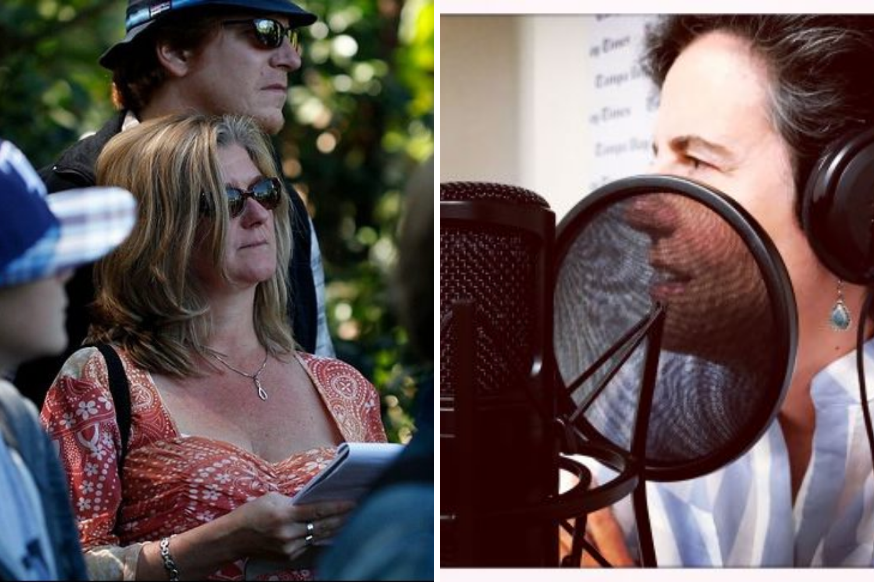
WRITELANE PODCAST
 | WriteLane podcast has a new home — back at Poynter, where it started WriteLane is perfect for journalists who like to talk shop, and for students and educators to learn more about process and craft www.poynter.org Link to the top episodes, categorized by topic: https://www.poynter.org/news/educators-students/writelane/

Slide 9
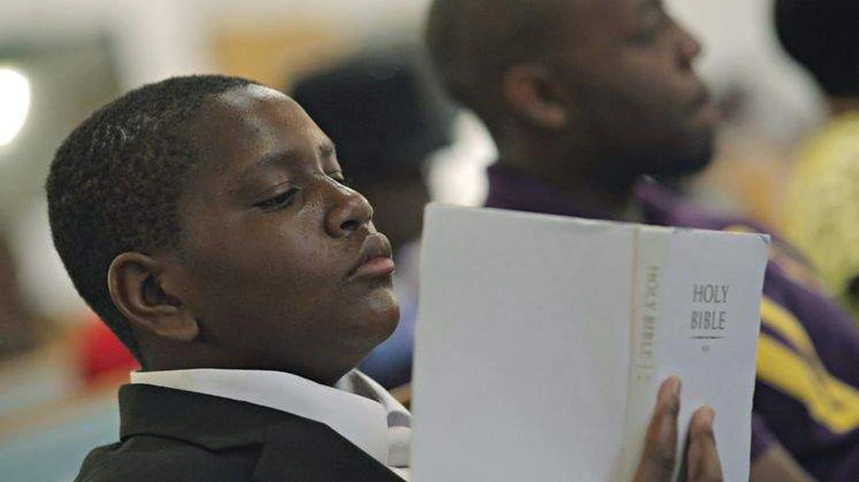
WRITELANE PODCAST
 | Amid churchgoers, orphan Davion Only pleads for a family This had been his idea. He'd heard something about God helping people who help themselves. So here he was, on a Sunday in September, surrounded by strangers, taking his future into his sweaty hands. https://www.tampabay.com/features/humaninterest/amid-churchgoers-orphan-pleads-for-a-family/2145907/

Slide 10
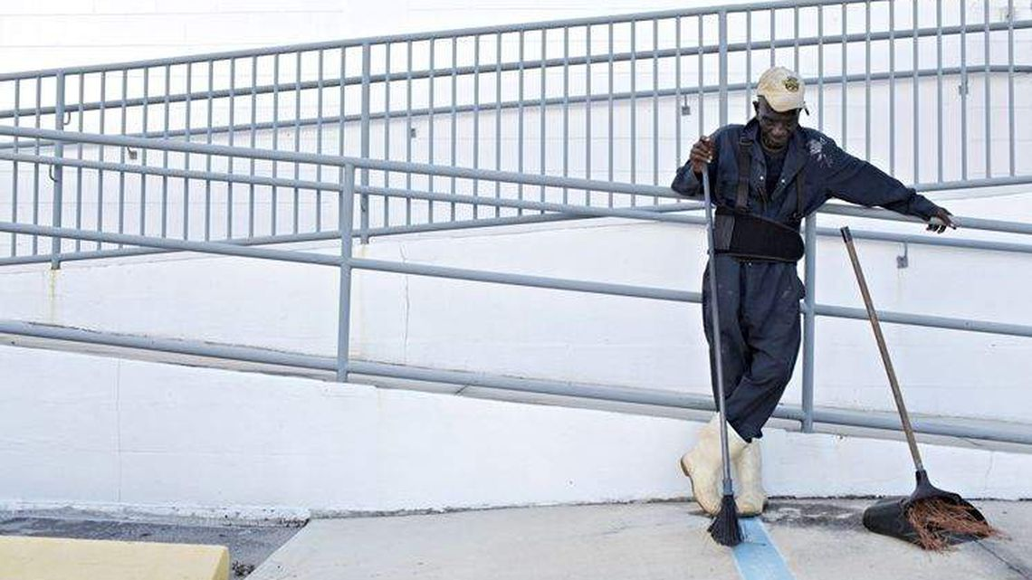
WRITELANE PODCAST
 | At 99, a St. Petersburg man finds meaning in the working life ST. PETERSBURG. His alarm beeps at 3:30 a.m., drowning out the talk radio that keeps him company all night. He rolls over slowly and prays: "Please, Lord, give me the strength to get up." https://www.tampabay.com/features/humaninterest/at-99-a-st-petersburg-man-finds-meaning-in-the-working-life/2132028/

Slide 11
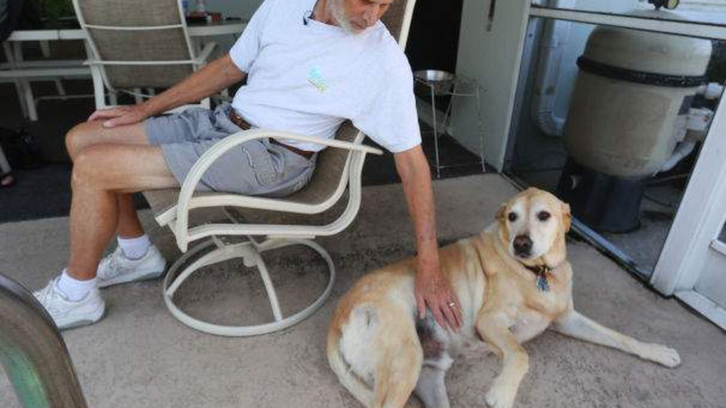
WRITELANE PODCAST
 | Time is short, but Zeke the Labrador lives to keep his owner alive - Tampa Bay Times When Gerald met Jeanne more than 30 years ago, he was running the National Museum of the U.S. Air Force in Dayton, Ohio. She was a real estate consultant who trained other Realtors. https://www.tampabay.com/features/https://www.tampabay.com/features/humaninterest/time-is-short-but-zeke-the-dog-lives-to-keep-his-owner-alive/2202849/

Slide 12
WRITELANE PODCAST
 | On Valentine's Day, a boy's rite of passage is finding the right words - Tampa Bay Their relationship revolves around the bus: waiting for it, sharing a seat, playing Flappy Bird on her iPod. Sometimes they hold hands. They can't eat lunch together because they have different ... https://www.tampabay.com/features/humaninterest/on-valentines-day-a-boys-rite-of-passage-is-finding-the-right-words/2165429/

Slide 13
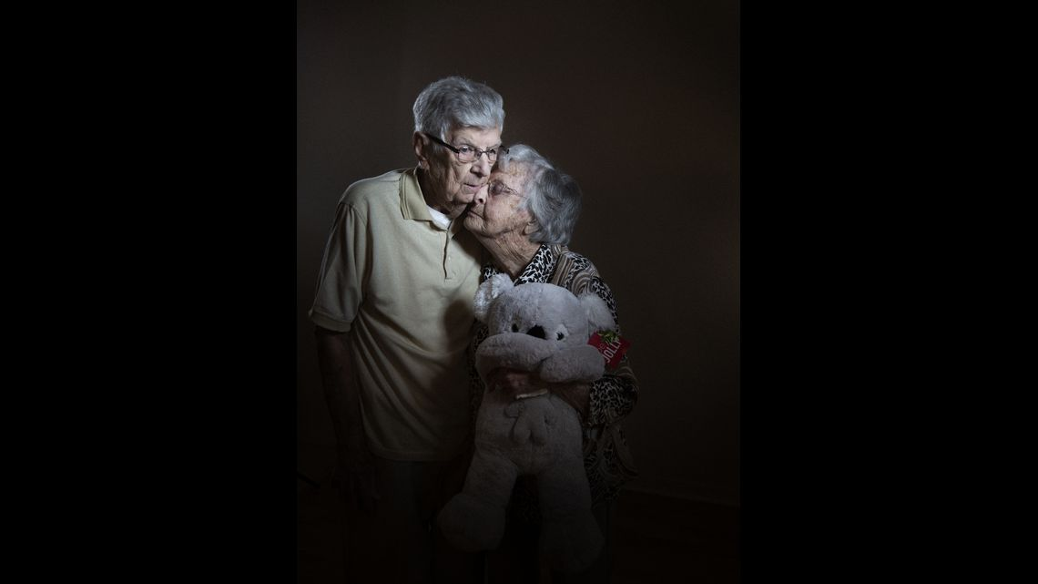
WRITELANE PODCAST
 | When Vivian was 6, she met a cute boy named Ray. 86 years later, this is their story. - tampabay.com Their love story spans eight decades, carried them to nine countries, gave them two children, two grandchildren, six great-grandkids. Ray and Vivian Whitehurst, both in their 90s, don’t leave ... https://www.tampabay.com/narratives/2020/02/14/vivian-whitehurst-was-in-the-second-grade-when-she-met-a-cute-boy-his-name-was-ray/

Slide 14
WRITELANE PODCAST
 | “I Brake for BOBO” “What Goes Up” https://www.tampabay.com/blogs/writelane/2018/09/10/episode-8-finding-great-ideas-part-two/ “Police Academy: Who wants to be a cop?” “The Girl in the Window” https://nieonline.com/tbtimes/special_investigations.cfm

Slide 15
Q & A

Slide 16
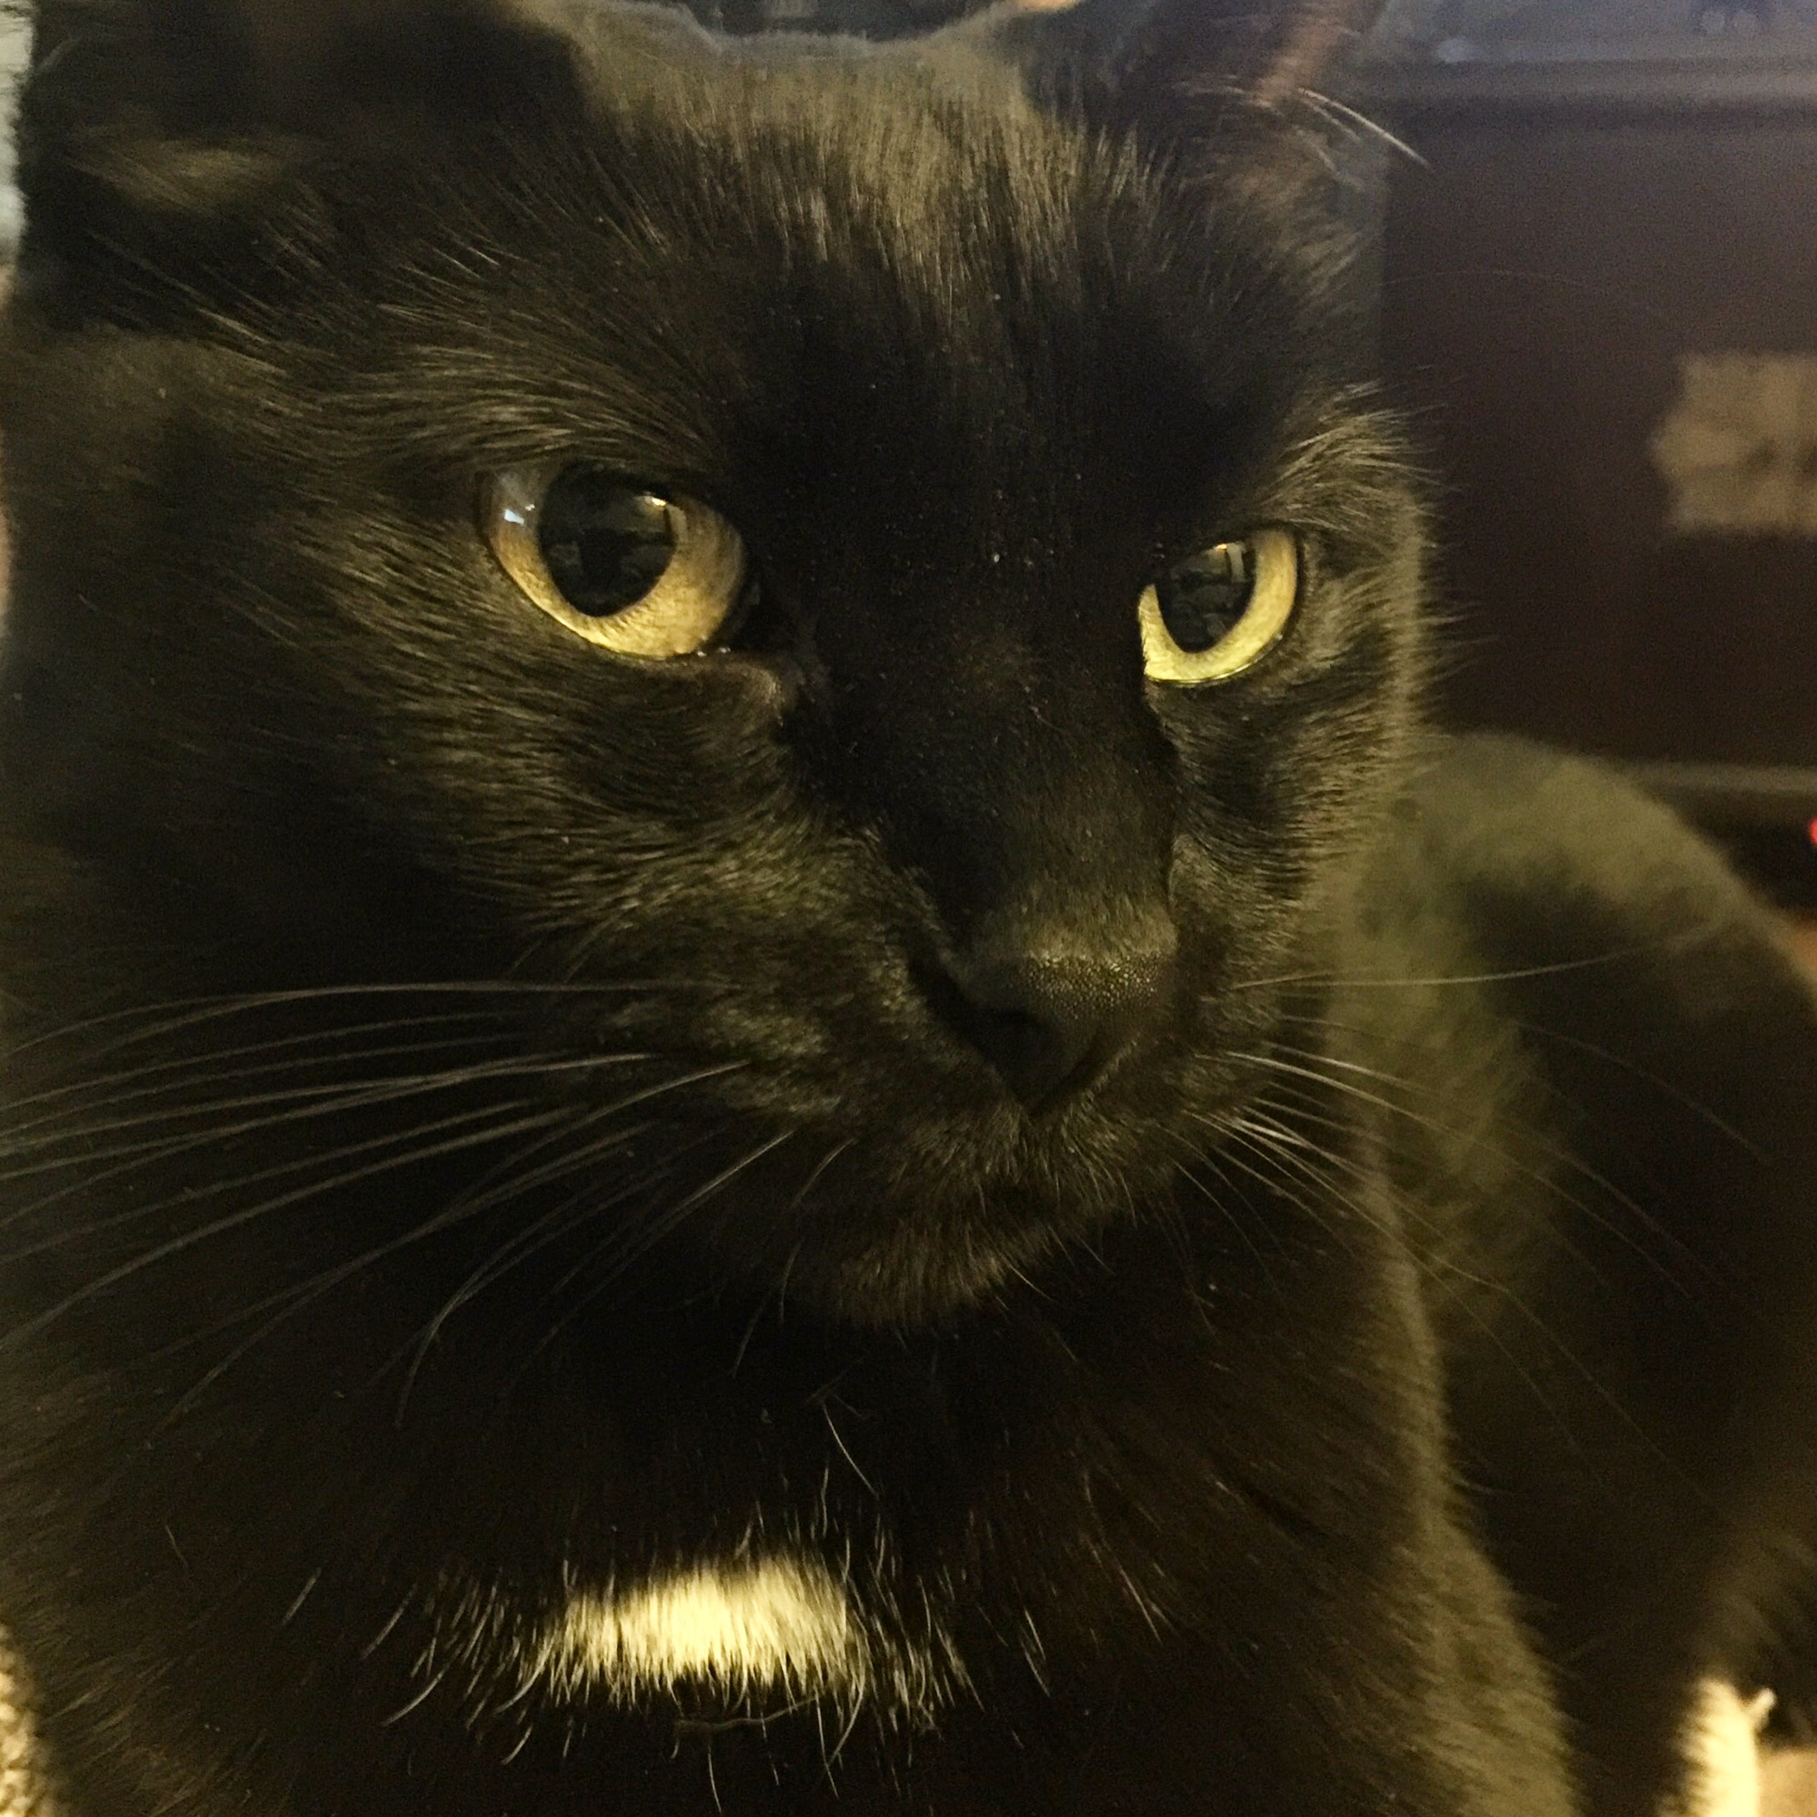
Let me introduce myself …
jpushkin@tampabay.com
Jodi Pushkin, manager and curriculum writer Tampa Bay Times Newspaper in Education program since 2005
Curriculum writer for NIE programs since 2000
Teacher since 1990
Currently adjunct professor at Saint Leo University, Pasco Hernando State College and Hillsborough Community College

Slide 17
The Tampa Bay Times Newspaper in Education program is a cooperative effort between schools and the Times to promote the use of newspapers in print and electronic form as educational resources.
The Times began its NIE program in the 1970s and we are one of the few newspapers in the nation still providing print copies of the newspapers free of charge to educators (in public, private, alternative and home schools).
The goal of NIE is to build future, life-long readers, productive citizens and critical thinkers.

Slide 18
Developing Daily Habits
Using the newspaper in your classroom and NIE curriculum on a regular basis helps students develop daily reading habits that they will carry through their lives.
The Times provides a vital link to the real world for students who too often do not realize the value of their academic programs. The study of today's critical issues, events and people helps students understand the past and see a role for themselves in their future world.

Slide 19
Why Use the Newspaper?
The terms “informational text” and “nonfiction” are often considered synonyms and used interchangeably. However, these types of texts are not the same.
According to Scholastic magazine, “Informational text is a type of nonfiction — a very important type. Nonfiction includes any text that is factual. (Or, by some definitions, any type of literature that is factual, which would exclude texts such as menus and street signs.) Informational text differs from other types of nonfiction in purpose, features, and format.”

Slide 20
Informational text
The information within the pages of the newspaper can be primary and secondary sources. The information can be fact and opinion.
The term informational text includes various types of texts:
Essays
Articles
Letters
Images
Cartoons
Photographs
Advertisements

Slide 21
Rhetoric
Rhetoric is using language effectively to persuade, inform, educate, or entertain.
The newspaper offers different forms of rhetoric in each of its sections: news, opinion, features, sports, comics, advertising, political cartoons, advertorials, photos.

Slide 22
Within that rhetoric are the three rhetorical appeals:
Logos or the appeal to reason relies on logic or reason. Logos often depends on the use of inductive or deductive reasoning.
Ethos or the ethical appeal is based on the character, credibility, or reliability of the writer.
Pathos, or emotional appeal, appeals to an audience's needs, values, and emotional sensibilities.

Slide 23
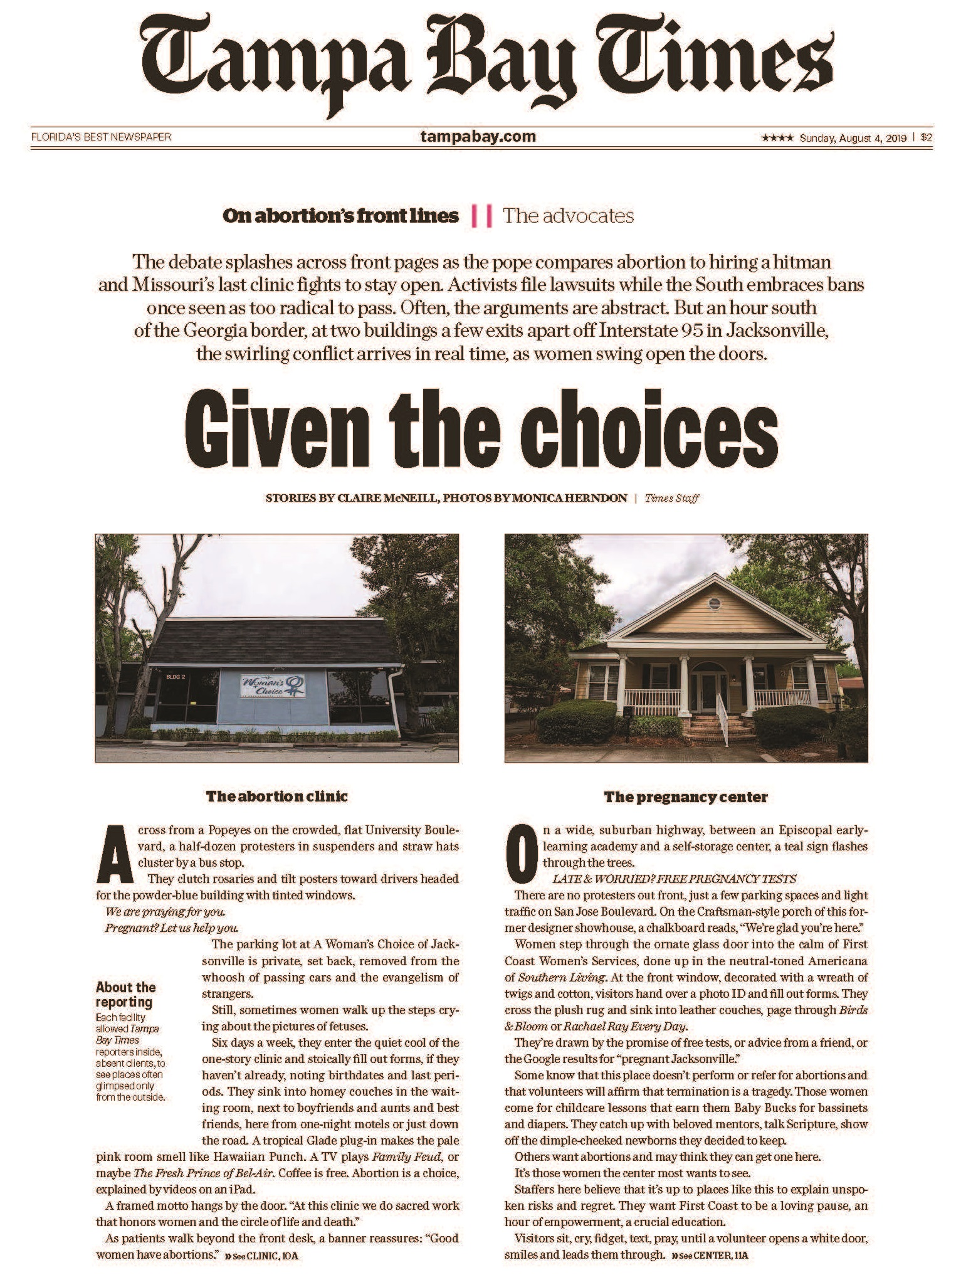
The W’s
Reading closely and looking for evidence:
Who?
What?
Why?
Where?
When?

Slide 24
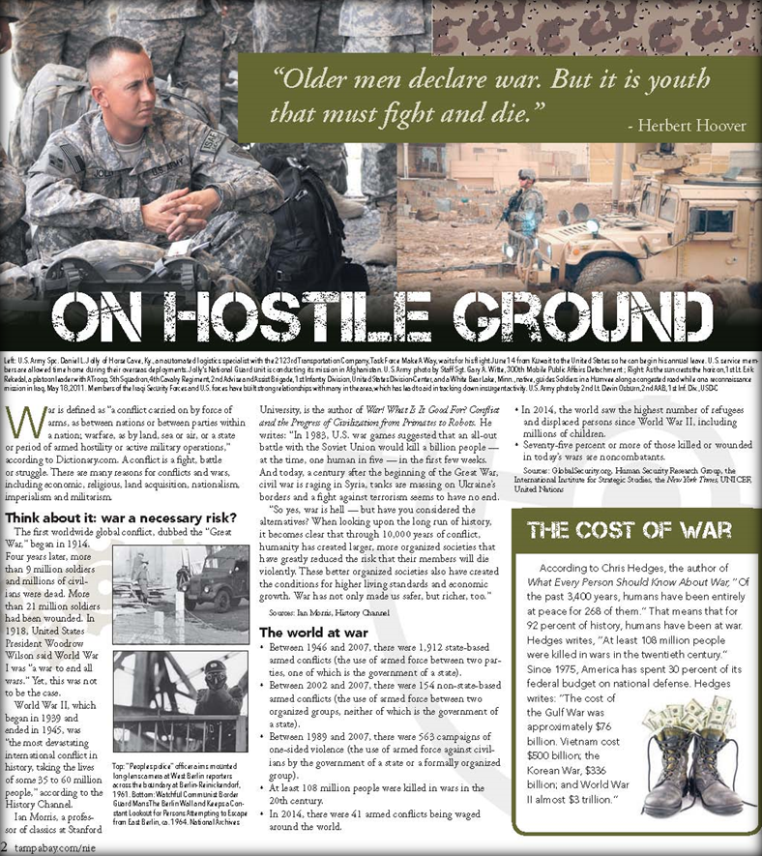
Evidence and Claims
What evidence does author provide?
What claims does author make implicitly?
Using the evidence, create an argument.

Slide 25
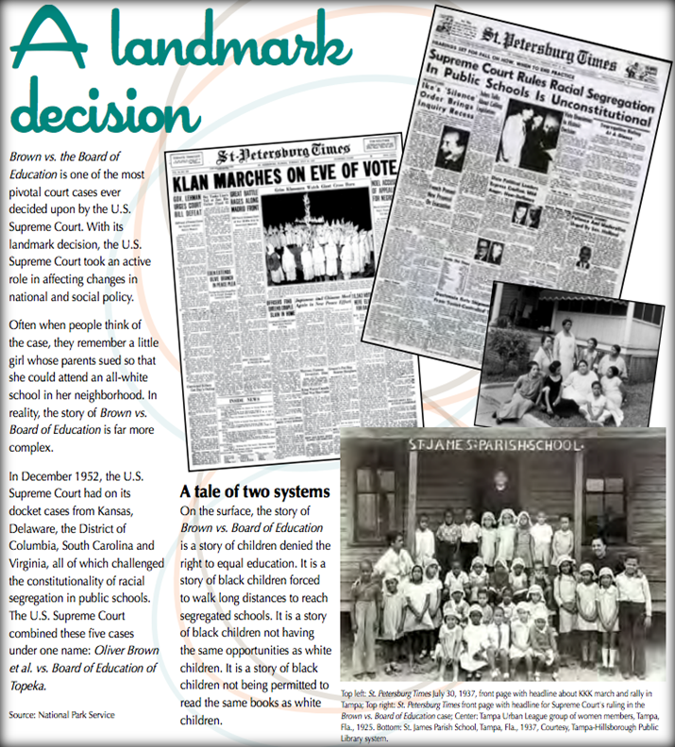
Inquiry and Investigation
Reading like a detective: Close Reading
Essential Question: Why is Brown vs. Education a Landmark Decision? (8-9)
Text dependent questions:
What is the basis of the Brown vs. Education case?
By reading through the text, what can you infer the definition of a “landmark decision” is?
Going beyond the text
Based on this text, how would schools in your area look, had the Supreme Court not ruled against segregation in 1954?

Slide 26
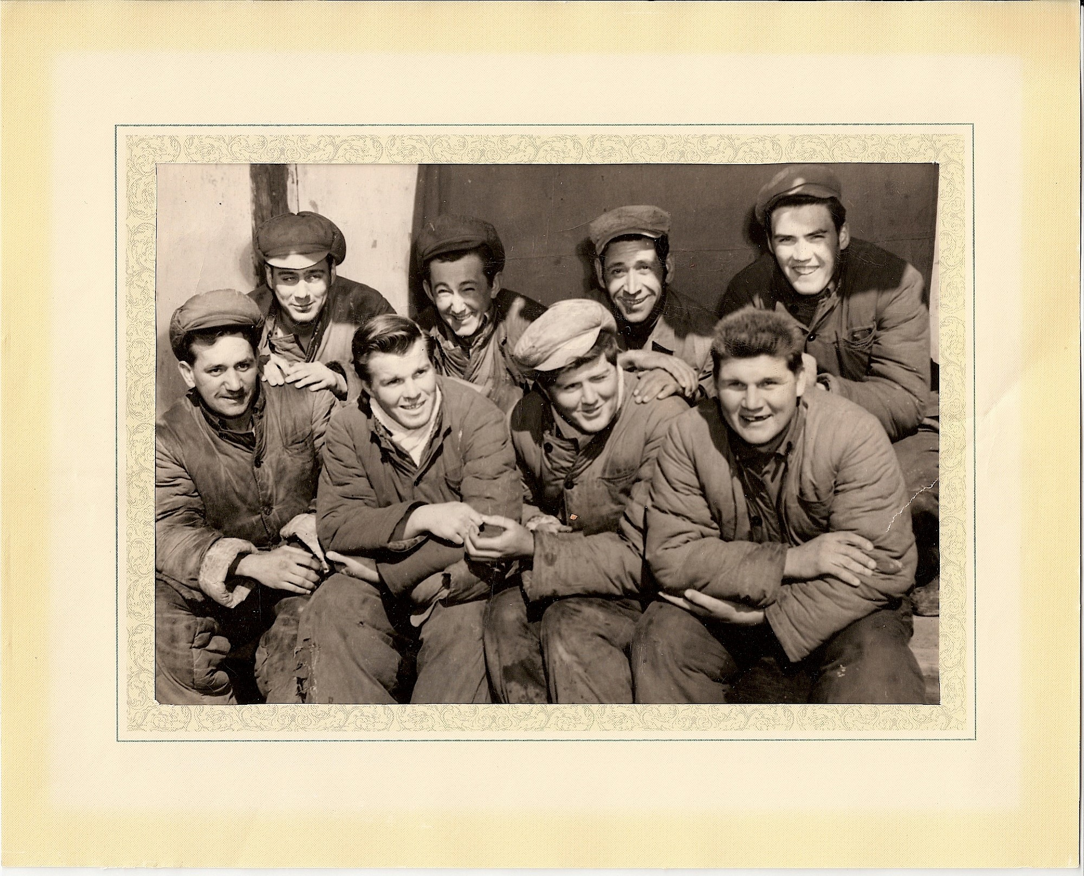
Interpreting images & graphics

Slide 27
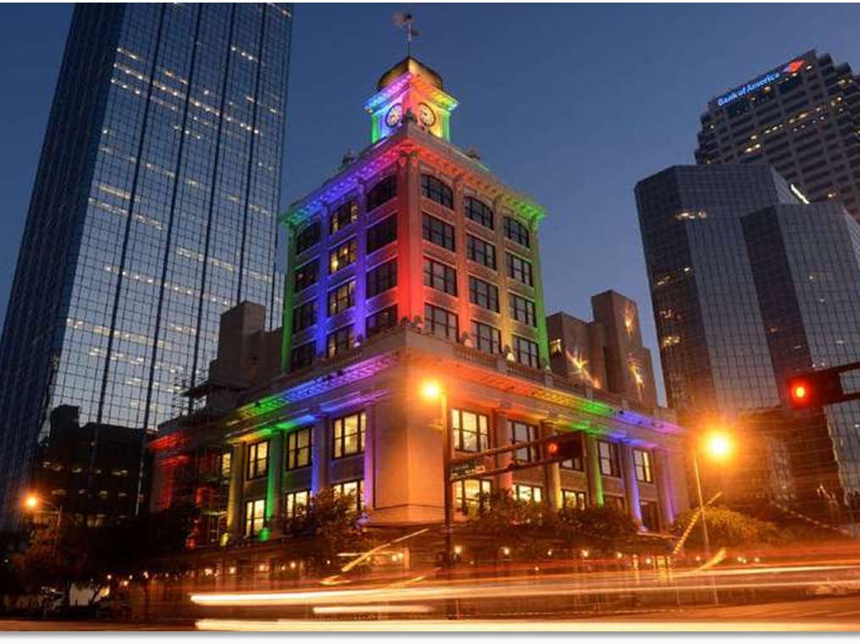
Interpreting Photos – All Eyes
tampabay.com/photos

Slide 28
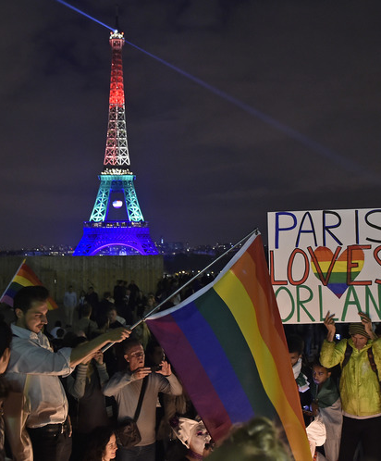
Interpreting photos … All Eyes
tampabay.com/photos

Slide 29
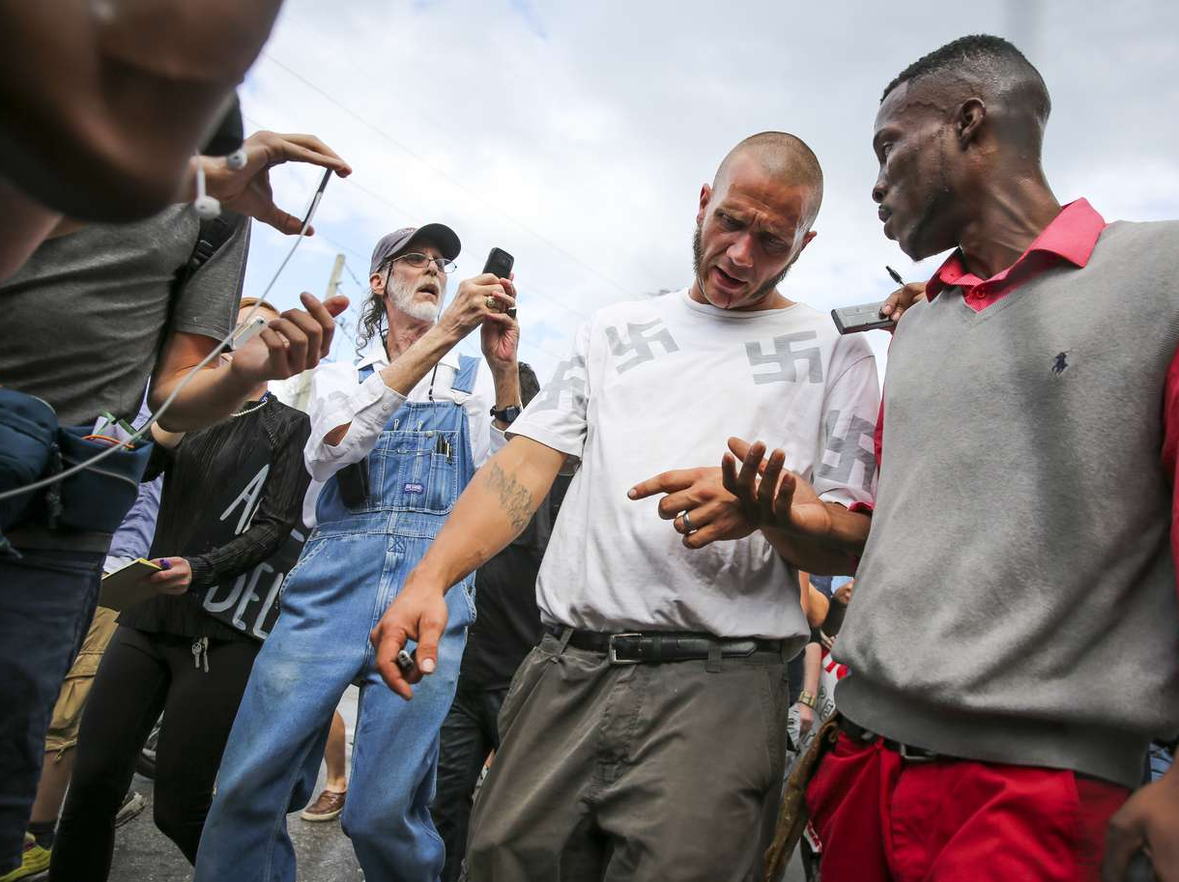
Interpreting Photos – All Eyes
tampabay.com/photos

Slide 30
Tampabay.com/nie
Tampabay.com/nie

Slide 31
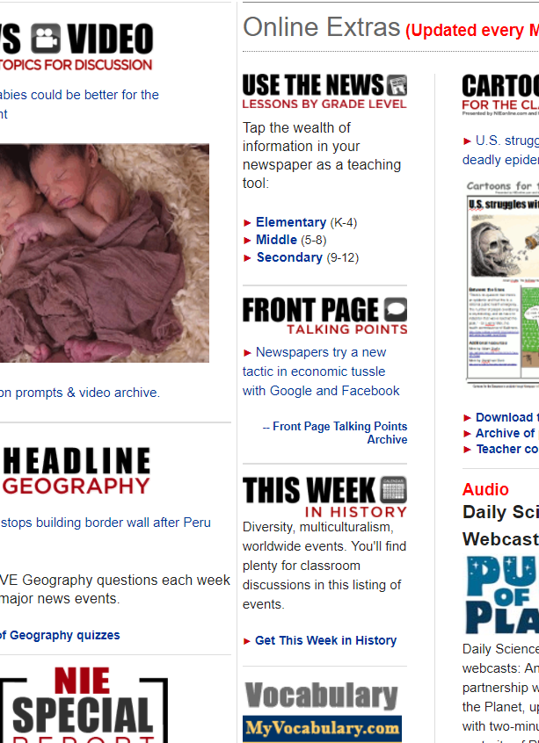
Resources
Resources

Slide 32
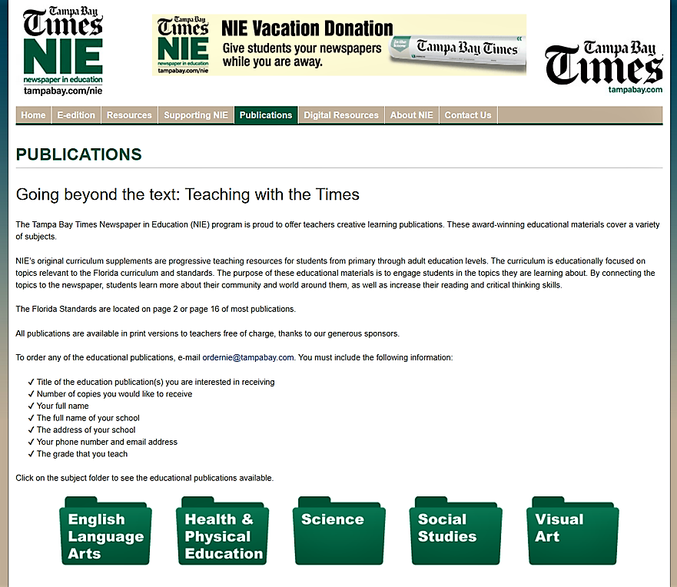
Publications

Slide 33
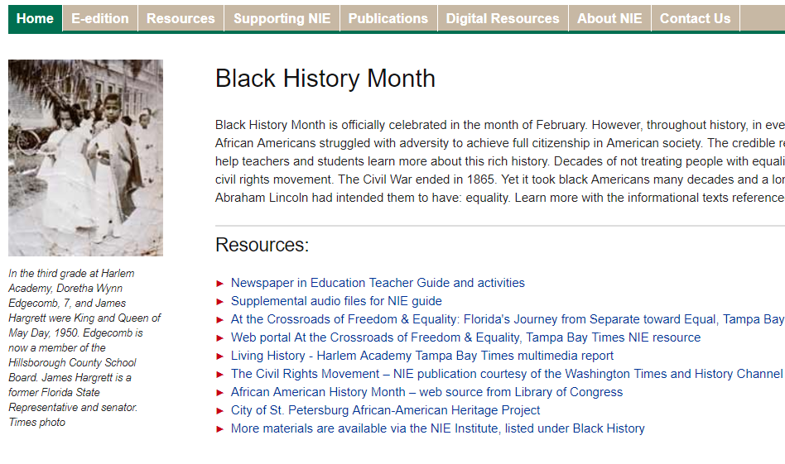
Black History Month

Slide 34
History
History

Slide 35
The Electronic Edition
Combining the use of print newspapers and technology in the classroom will engage your struggling readers, bored underachievers or IB/advanced students. We encourage you to have your students use the electronic edition at school and home.

Slide 36
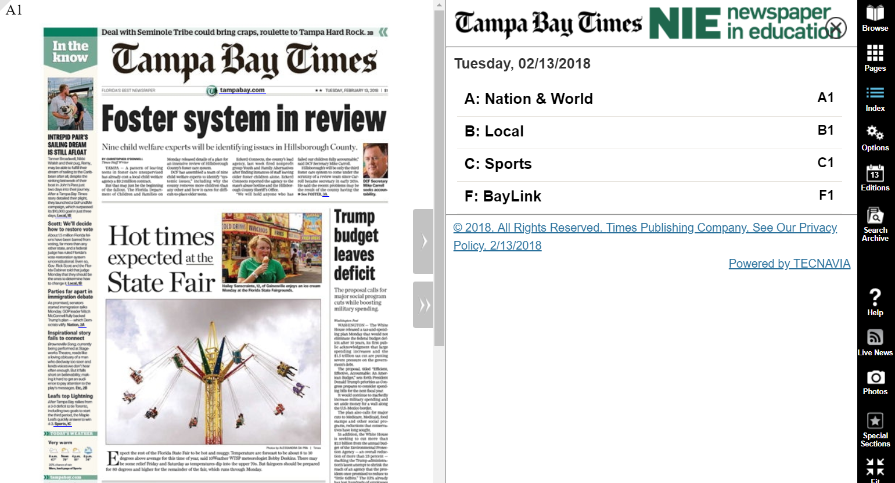
Digital Edition

Slide 37
Digital edition Cool features
Access
You can access all seven editions in all counties.
E-Mail
E-Mail Articles to your friends or family.
Print
Save or print the articles you want to keep.
Search
Search for past articles.
E-mail
E-mail notification for research and projects.

Slide 38
Convenient
The digital edition can be accessed on any computer or electronic device with Internet access. You and your students can download the android and iTunes apps for more convenience.
If you are using the digital edition for a class lesson, one computer, license and projector is all you need. Online writing prompts are available on our tampabay.com/nie website as well.

Slide 39
Accessing the Digital Edition
Teachers, students, and parents should use the same user name and password:
Go to tampbay.com/nie
Click log in here
Enter user name
Enter password
Select preferred edition
Click remember me box
Click Log in

Slide 40
Jodi Pushkin, manager
jpushkin@tampabay.com
727-893-8961
NIE Website: tampabay.com/nie
NIE Email address: ordernie@tampabay.com
Phone number: 727-893-8138
Twitter: Twitter.com/TBTimesNIE
Facebook: Facebook.com/TBTNIE

