Slide 1
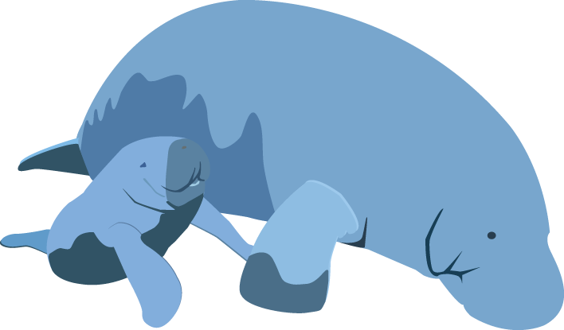
Educational Resources from the Southwest Florida Water Management District
Presenter: Katherine Munson

Slide 2
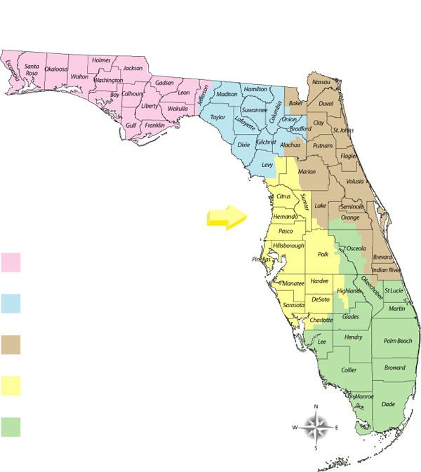
One of five water management districts
Responsible for managing and protecting water resources
Created by Chapter 373 F.S. Water Resources Act (1972)

Slide 3
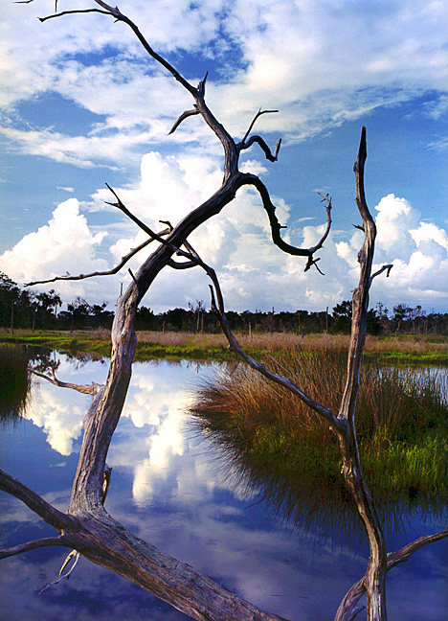
Areas of Responsibility
Water Supply
Flood Protection
Water Quality
Natural Systems

Slide 4
Florida’s Water Supply
53 inches of rain annually
60% of rainfall occurs June – Sept.

Slide 5
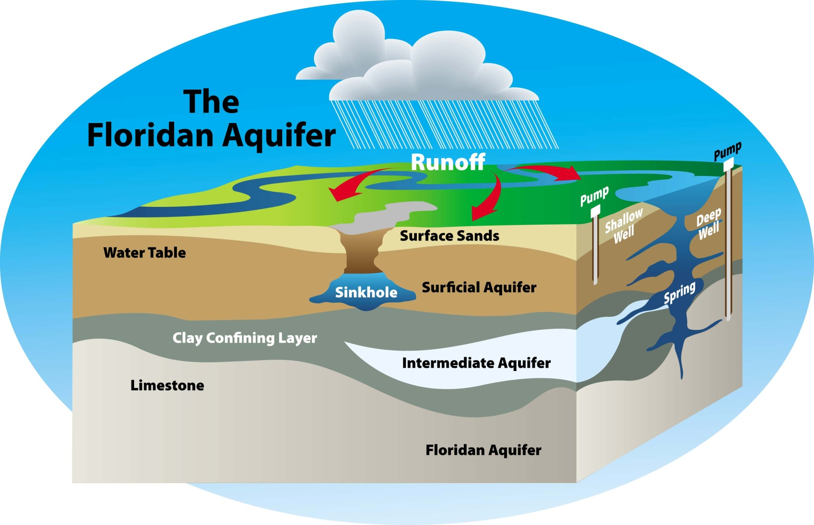
Groundwater supplies majority of public water supply in our area.

Slide 6
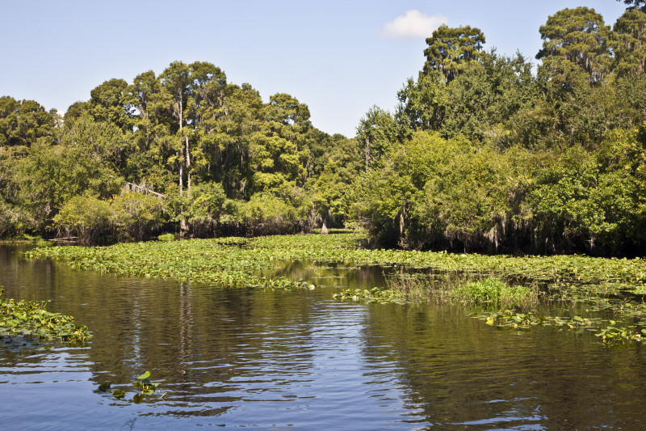
Surface Water
Hillsborough River

Slide 7
What is a watershed?
A watershed is an area of land that water flows across as it moves toward a common body of water, such as a stream, river, lake or coast.

Slide 8
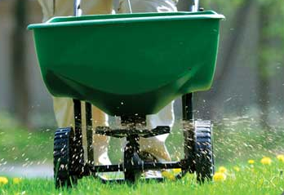
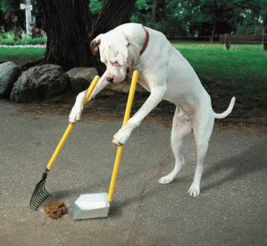
Human actions on land AFFECT our waters
Most obvious source - stormwater runoff

Slide 9
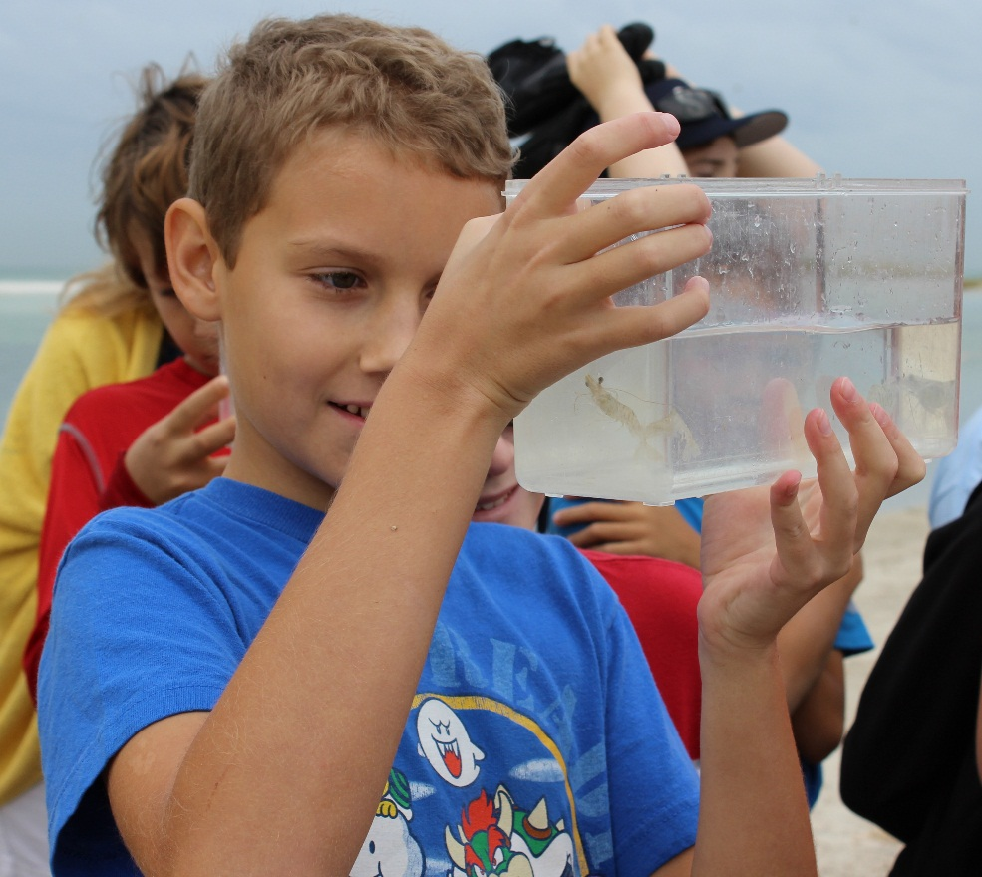
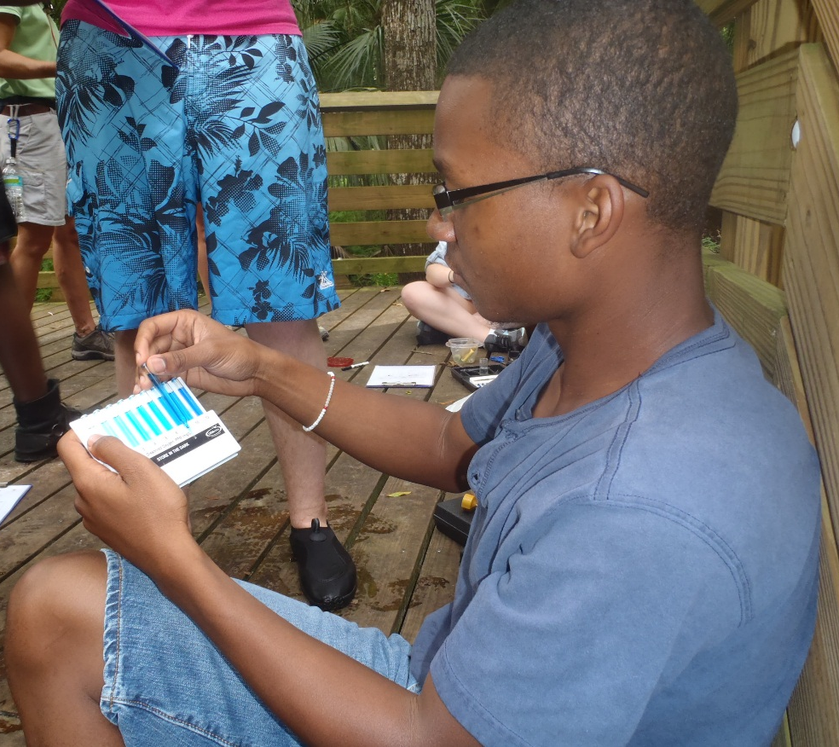
Why does SWFWMD educate youth?

Slide 10
How SWFWMD educates youth
Educational Resources
School Board Funding
Grade-level field studies
Polk Nature Discovery Center third- through fifth-grade program in Polk County
Teacher training
Project WET and others
Envirothon funding
Transportation for participating teams

Slide 11
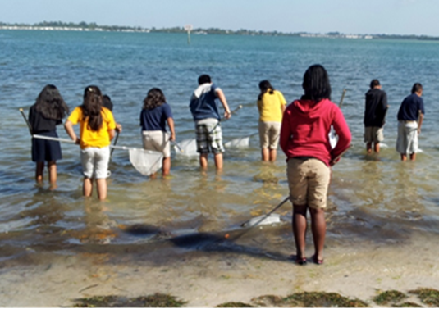
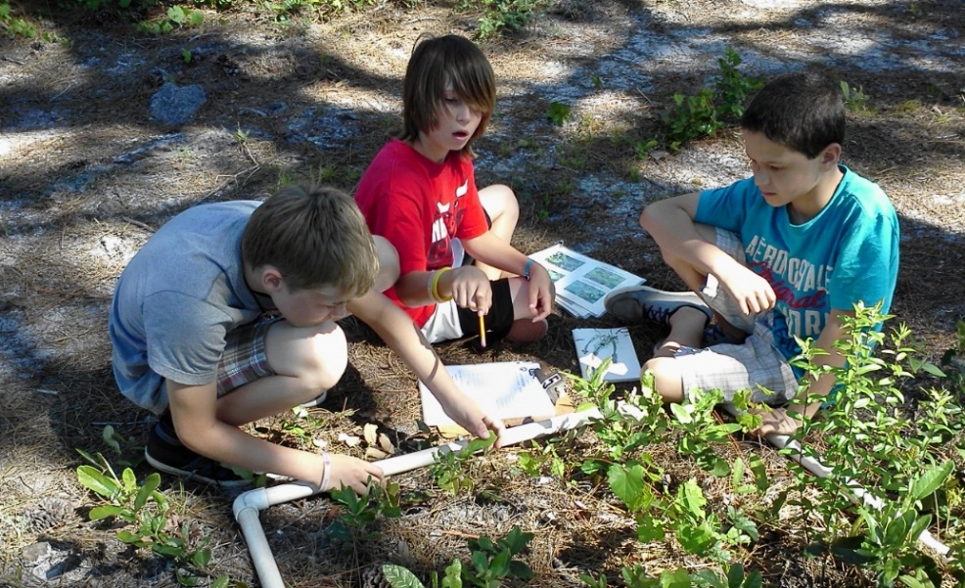
Splash! School Grants
Available to public and charter school teachers, grades K-12
Up to $3,000 awarded per school
Grants follow one of four templates and provide hands-on learning opportunities

Slide 12
SWFWMD Website
WaterMatters.org

Slide 13
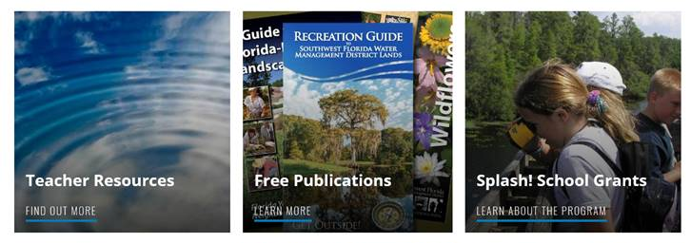
WaterMatters.org/Education
Teacher Resources
Free Publications
Splash! Grants

Slide 14
WaterMatter.org/Education
VISIT THIS SITE!
Your one-stop-shop of free water-resources educational materials
Most resources are correlated to the state education standards

Slide 15
Water Education Videos
Water cycle
Water habitats
Wetlands
Watersheds
Groundwater
Water quality
Alternative water supply

Slide 16
Virtual Watershed Excursions
Alafia River
Green Swamp
Hillsborough River
Peace River
Southern Coastal
Springs Coast
Withlacoochee River

Slide 17
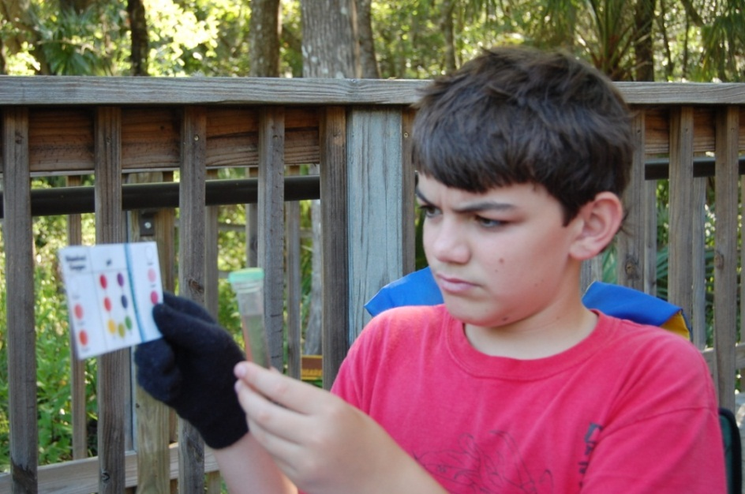
Order free test kits
Participate in the

Slide 18
Hands-on Activity Ideas

Slide 19
Classroom Conservation Challenge

Slide 20
Order FREE Materials

Slide 21
POSTERS
Common Species in west-central Florida
Water Words

Slide 22
Find SWFWMD Online
WaterMattersTV
@SWFWMD
@SWFWMD

Slide 23
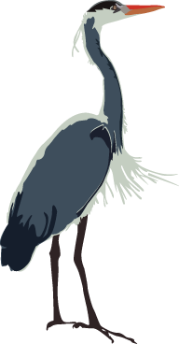
Contact Information
Katherine Munson
Senior Communications Coordinator
Toll-free: 800.423.1476, ext. 4405
Katherine.Munson@WaterMatters.org

