Slide 1


Tampabay.com/nie

Slide 2
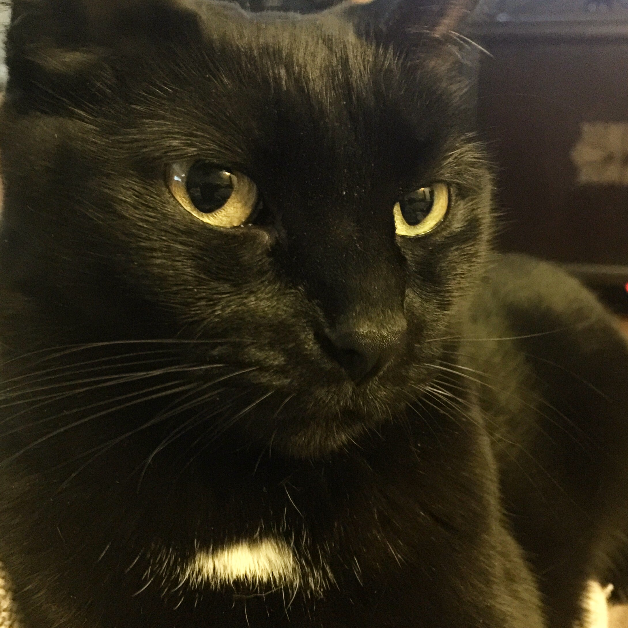
Let me introduce myself …
jpushkin@tampabay.com
Jodi Pushkin, manager and curriculum writer Tampa Bay Times Newspaper in Education program since 2005
Curriculum writer for NIE programs since 2000
Teacher since 1990
Currently adjunct professor at Saint Leo University, Hillsborough Community College and Pasco Hernando State College

Slide 3

The Tampa Bay Times Newspaper in Education program is a cooperative effort between schools and the Times to promote the use of newspapers in print and electronic form as educational resources.
The Times began its NIE program in the 1970s and we are one of the few newspapers in the nation still providing print copies of the newspapers free of charge to educators (in public, private, alternative and home schools).
The goal of NIE is to build future, life-long readers, productive citizens and critical thinkers.

Slide 4
Using the Times
The newspaper is an important form of informational text. It is both a primary and secondary source, which can be used in all subjects and grade levels. If you are planning to encourage students to use the digital edition at home, make sure the number of licenses requested reflects the anticipated student numbers. The number of licenses ordered (plus print copies) cannot exceed the number of students you teach though.
If you have questions, would like to change your user name, or need assistance, email ordernie@tampabay.com.

Slide 5

Developing Daily Habits
Using the newspaper in your classroom and NIE curriculum on a regular basis helps students develop daily reading habits that they will carry through their lives.
The Times provides a vital link to the real world for students who too often do not realize the value of their academic programs. The study of today's critical issues, events and people helps students understand the past and see a role for themselves in their future world.

Slide 6

Why Use the Newspaper?
The terms “informational text” and “nonfiction” are often considered synonyms and used interchangeably. However, these types of texts are not the same.
According to Scholastic magazine, “Informational text is a type of nonfiction — a very important type. Nonfiction includes any text that is factual. (Or, by some definitions, any type of literature that is factual, which would exclude texts such as menus and street signs.) Informational text differs from other types of nonfiction in purpose, features, and format.”

Slide 7
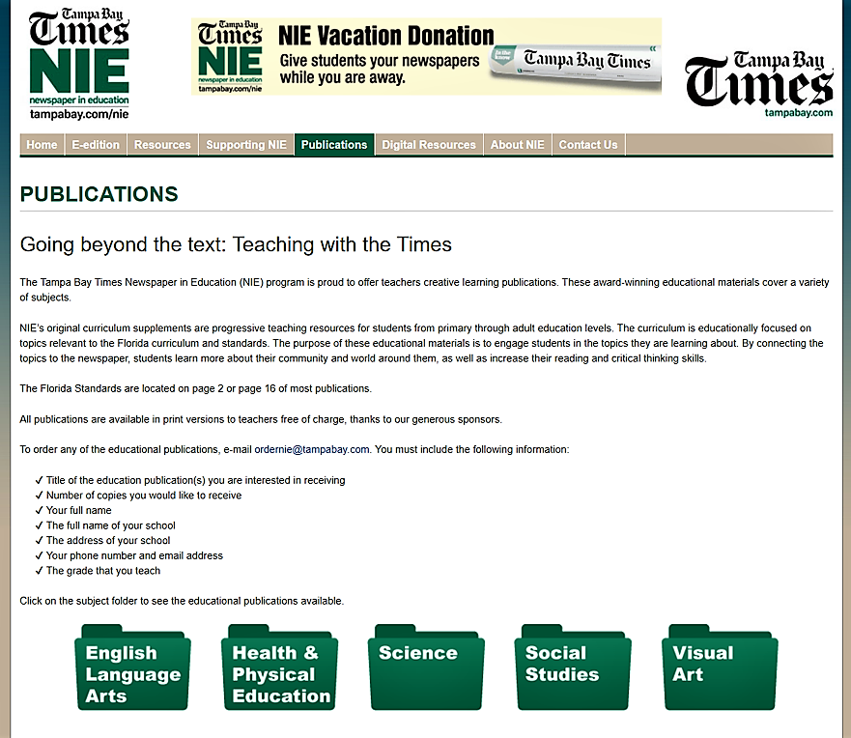
Publications

Slide 8

History
Science

Slide 11
The water cycle

Slide 12
Protecting the environment

Slide 14
Flowing water, watersheds, springs

Slide 15
Safe drinking water

Slide 16
Ecosystems

Slide 17
Florida water habitats

Slide 18
Biodiversity

Slide 25
Going beyond the text

Slide 26
Using the Digital Edition
You and your students can read the Tampa Bay Times, just as it appears in the printed edition, from the convenience of your computer, phone, tablet or electronic reading device.
  Classwork
  Homework
  Research
  Writing models
  Grammar and math exercises

Slide 27
Digital Edition: Special Features
The digital edition can be accessed on any computer or electronic device with Internet access. However, not all special features are available on the apps. If you would like to use the translation, audio, print and archive features, you will need to log in using a computer.

Slide 28
The Electronic Edition
Combining the use of print newspapers and technology in the classroom will engage your struggling readers, bored underachievers or IB/advanced students. We encourage you to have your students use the electronic edition at school and home.
  Go to www.tampabay.com/nie
  Click on Log in here
  Enter class user name
  Enter password (news)

Slide 29
Step 1
To sign up for the digital edition of the Tampa Bay Times for your classroom, go to tampbay.com/nie, and click Sign up here. Then fill out the online request form.*
The number of licenses you order should correspond to the number of students who will access the Times at the same time. Usually that is a class set.
* By placing an order on our website, you agree to also verify the order for our auditing purposes.

Slide 30

Accessing the Digital Edition
  Teachers, students, and parents should use the same user name and password:
    Go to tampbay.com/nie
    Click log in here
    Enter user name
    Enter password
    Select preferred edition
    Click remember me box
    Click Log in

Slide 31

Digital edition
Cool features
Access
You can access all seven editions in all counties.
E-Mail
E-Mail Articles to your friends or family.
Print
Save or print the articles you want to keep.
Search
Search for past articles.
E-mail
E-mail notification for research and projects.

Slide 32
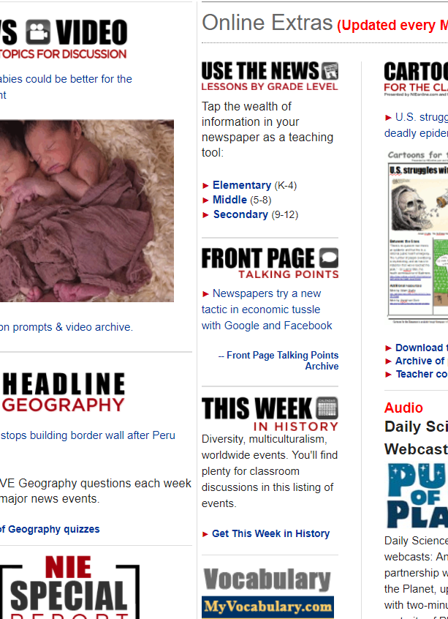
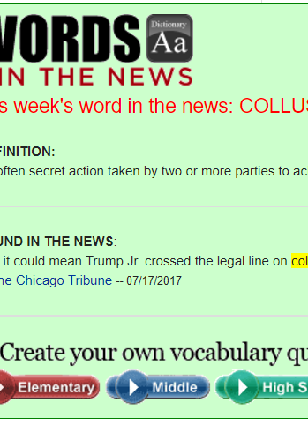

Resources
Resources

Slide 33
Jodi Pushkin, manager
jpushkin@tampabay.com
727-893-8961
NIE Website: tampabay.com/nie
NIE Email address: ordernie@tampabay.com
Phone number: 727-893-8138
Twitter: Twitter.com/TBTimesNIE
Facebook: Facebook.com/TBTNIE

